Slide 1
Is the Lean Organisation a Complex System?
Interim report on Pierre Masai’s PhD,
June 19th, 2015

Slide 2
1.1 Research article for KES2015
KES2015 = Knowledge Engineering Systems.
The 2015 conference will be in September.
The paper has been approved for publication.
The focus is on the application of the KREM Model to the Lean Organisation.
A high level ontology of Lean is presented and applied to the concrete case of the Hoshin Kanri process, modelled with a Markov Chain.

Slide 3
1.2 KES2015 Abstract
In this paper, we describe the characteristics of the Lean Enterprise and make the case for modelling it in order to reproduce its successful practices more easily.
The literature contains many good descriptions of the Toyota Production System and Lean in general, but no formal model that we can build upon.
We then make the hypothesis that Lean is a Complex System, which can be modelled formally.
We propose to follow the KREM model.
A practical example modelling the Hoshin Kanri process for setting objectives at the enterprise level demonstrates how to put this approach into practice.

Slide 4
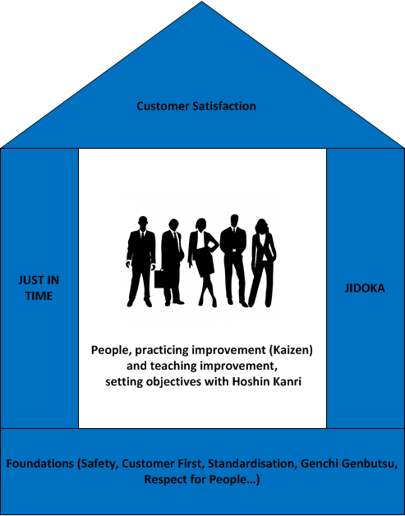
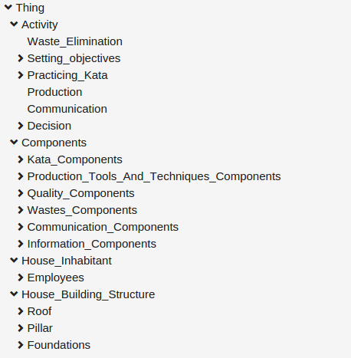
1.3 Lean Ontology
The House of TPS, basis of the Lean Ontology

Slide 5
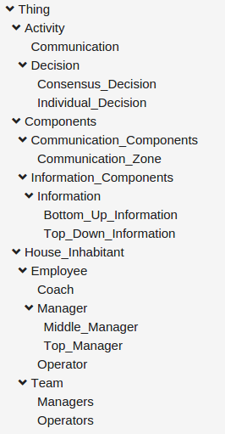
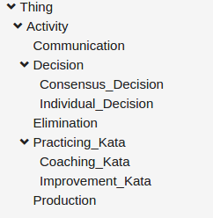
1.4 Taxonomy of the ontology of Lean Artefacts involved in the Hoshin Kanri

Slide 6
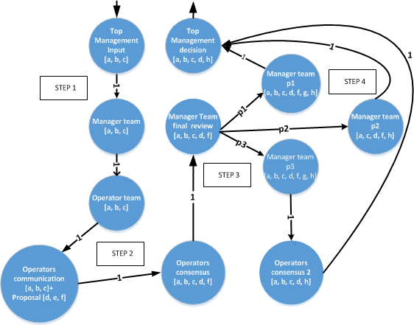
1.5 Hoshin Kanri process modelled as a Markov Chain

Slide 7
2.1 Article for CS-DC
eConference of the Complex Systems Digital Campus.
Abstract submitted on 15/6/2015
Short article (6 pages) in redaction phase towards deadline of 30/6/2015.
The focus is on concrete modelling of two lean processes (Nemawashi and Hoshin Kanri), programmed in Python, then with Drools (rules engine) to show their emerging behaviour.

Slide 8
2.2 Abstract
Title: « Is the Lean Organisation a Complex System? »
What is Lean?
What are Complex Systems?
Modelling Complex Systems
Modelling Lean (Nemawashi, Hoshin Kanri)
Simulation (simulation and execution results)
Discussion (selected properties – modelling)

Slide 9
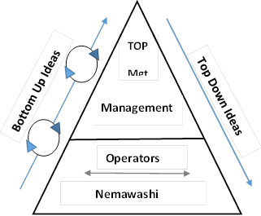
2.3 Hoshin Kanri

Slide 10
2.4 Modelling the Hoshin Kanri
Management of objectives
Generate items
Three levels of employees (operators, managers, top managers)
Top Down and Bottom Up
90 days simulation, initiated by Top Management, three main nemawashi days
Generation of items at random, with acceleration towards the end
Evaluation function based on experience and competence of the employees.
Show dependence to initial conditions and emergence.

Slide 11
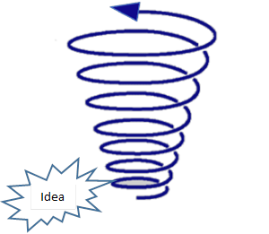
2.5 Modelling the Nemawashi
Initialisation with a list of items (i1, … in)
Spiral up the management layers
Replace items based on a random generator and an evaluation function like that of the Hoshin But: strong input of Management possible through signature.
Top Mgt
Management
Employee

Slide 12
3. Next Steps
Get CS-DS article approved
Write book chapter on Lean Ontology/Culture by end of July
Create a more thorough Lean Ontology in Protege, capturing more of my experience
Put all of this together to write the first third of the PhD in the second half of this year and continue the modelling/practical experimentation leading to model improvements.

